Slide 1

Talent Recommendation System
A Generative AI-powered recruitment system that matches job postings with candidate profiles using embeddings and similarity scoring.

Slide 2
Project Objectives
Automate Shortlisting
Intuitive Interface
Use AI to automatically identify top candidates for each role.
Provide recruiters with a simple, user-friendly web platform.
AI Integration
Rapid Deployment
Leverage embeddings and LLMs to compare job descriptions with candidate profiles.
Deliver an end-to-end proof-of-concept within limited timeframe.

Slide 3

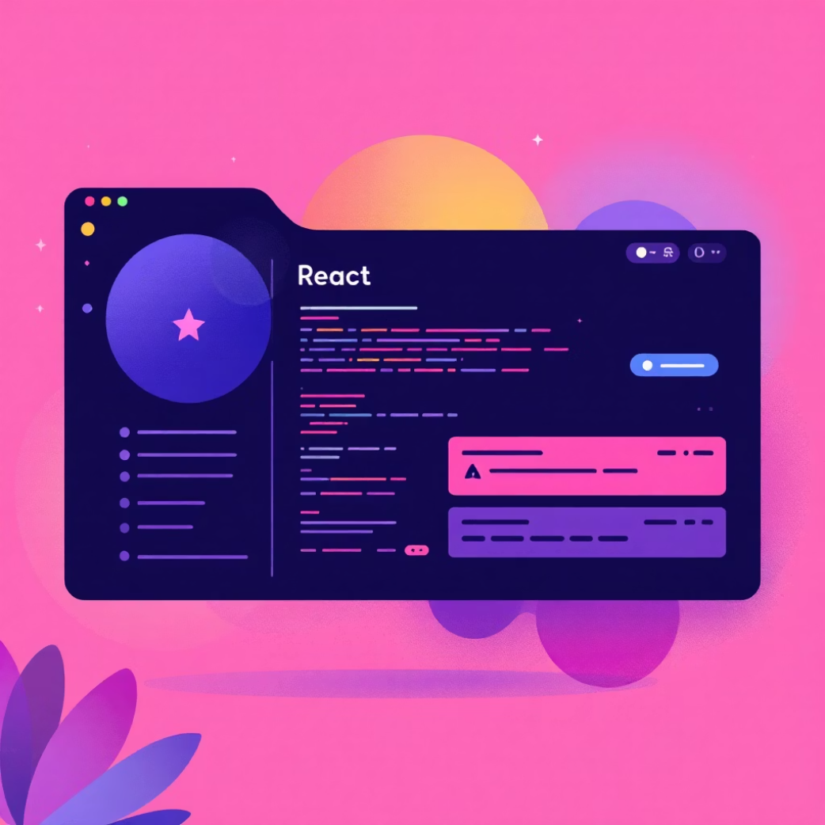

Technology Stack
Backend
Frontend
AI/ML & Deployment
Python
React
Sentence-transformers
Flask
Tailwind CSS
Gemini/OpenAI API
Gunicorn
Dark theme UI
Render & Vercel

Slide 4

System Architecture
Recruiter UI
Flask API
Embedding Model
Ranked Candidates
The system processes job requirements through AI embeddings to deliver ranked candidate recommendations.

Slide 5
Core Features
01
02
Job Role Selection
AI-Powered Ranking
Recruiter selects a job from dropdown menu interface.
Candidates scored by similarity using advanced embeddings.
03
04
Top 10 Results
Optimized UI
System delivers ranked list of best-matched candidates.
Dark theme, minimal interface designed for recruiters.

Slide 6




Advanced Matching Capabilities
Hobby-Based Matching
Language Matching
Sentiment Analysis
Match candidates with "animals" interests to animal content creator roles.
Connect multilingual candidates with appropriate international positions.
Analyze creativity and personality traits for better cultural fit.

Slide 7



Quick Setup Guide
Clone Repository
git clone https://github.com/suthargithub/talent-recommender.gitcd talent-recommender
Backend Setup
cd backendpip install -r requirements.txtpython app.py
Runs at: http://localhost:5000
Frontend Setup
cd frontendnpm installnpm run dev
Runs at: http://localhost:3000

Slide 8

Evaluation Criteria
1
2
3
Technical Fluency
Integration Skills
AI Implementation
Python + Flask backend, React frontend implementation.
Seamless frontend ↔ backend API communication.
Effective use of embeddings for recommendations.
4
5
Code Quality
Innovation
Organization, comments, and documentation standards.
Creative features beyond basic requirements.

Slide 9
Future Development Roadmap
Resume Parsing
1
PDF/DOCX → embeddings for comprehensive candidate analysis.
2
ATS Integration
Connect with existing Applicant Tracking Systems.
Vector Database
3
Implement Pinecone or FAISS for large-scale candidate search.
4
Advanced Filters
Experience, location, and skills-based filtering options.
Explainable AI
5
"Why was this candidate ranked higher?" transparency features.

Slide 10



Ready to Transform Recruitment
An end-to-end AI solution that revolutionizes how recruiters discover and match top talent with the perfect opportunities.
Key Achievement
Next Steps
Delivers Top 10 ranked candidates using advanced AI embeddings and similarity scoring.
Ready for deployment and real-world testing with recruitment teams.

